Slide 1
Julian Jumper
Postmortem

Slide 2
Introduce The Team
Kevin Hall – Game Play Programmer
Pause Logic/General Game play
Liam Hans - Graphics Programmer
Rendering System and text.
Eyon Norman- Game Play Programmer
Collision Master/ General Game play
Shawn Newline - Generalist Programmer
Blender, Python script.
Douglas Strange - Lead Programmer
Git, Organization

Slide 3
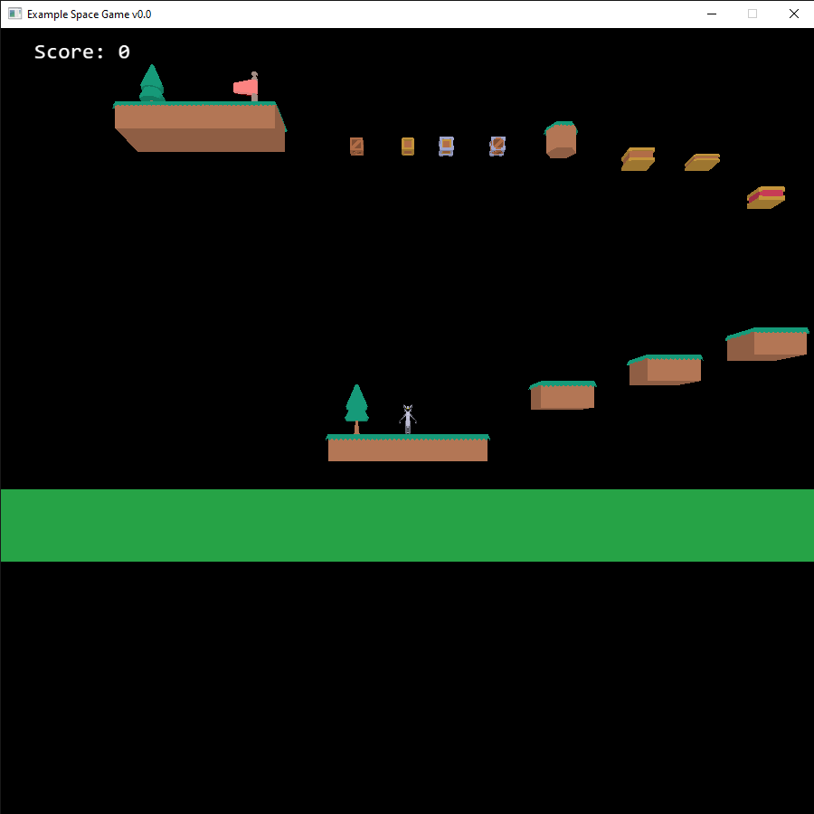

Introduce The Game
Inspiration-Donkey Kong
Platformer
Was a game everyone was familiar with and an all-time classic.

Slide 4
Demo

Slide 5
What Went Right?
We were able to get the rendering system in place early on in the month which helped give us time to focus on other parts.
We maintained a strict schedule, which we kept to.
People helped on parts they weren’t assigned.
Were able to implement game end logic.

Slide 6
What Went Wrong?
Had to move away from Donkey Kong
Git issues
We were very organized and kept an open line of communication
We had a tough time getting collisions working.
We sadly were not able to implement level switching.
Flecs and Ecs took time getting used to.

Slide 7
Lessons Learned
We originally wanted to make Donkey Kong and realize now that was unrealistic.
Figure out how to correctly destroy and re-initialize entities.
Make better working directories, Douglas had trouble with multiple merge conflicts
We were working on Alpha material in the Gold sprint.

Slide 8
Audience Questions and Answers

